Slide 1
Location eda and ml
Khoa Truong

Slide 2
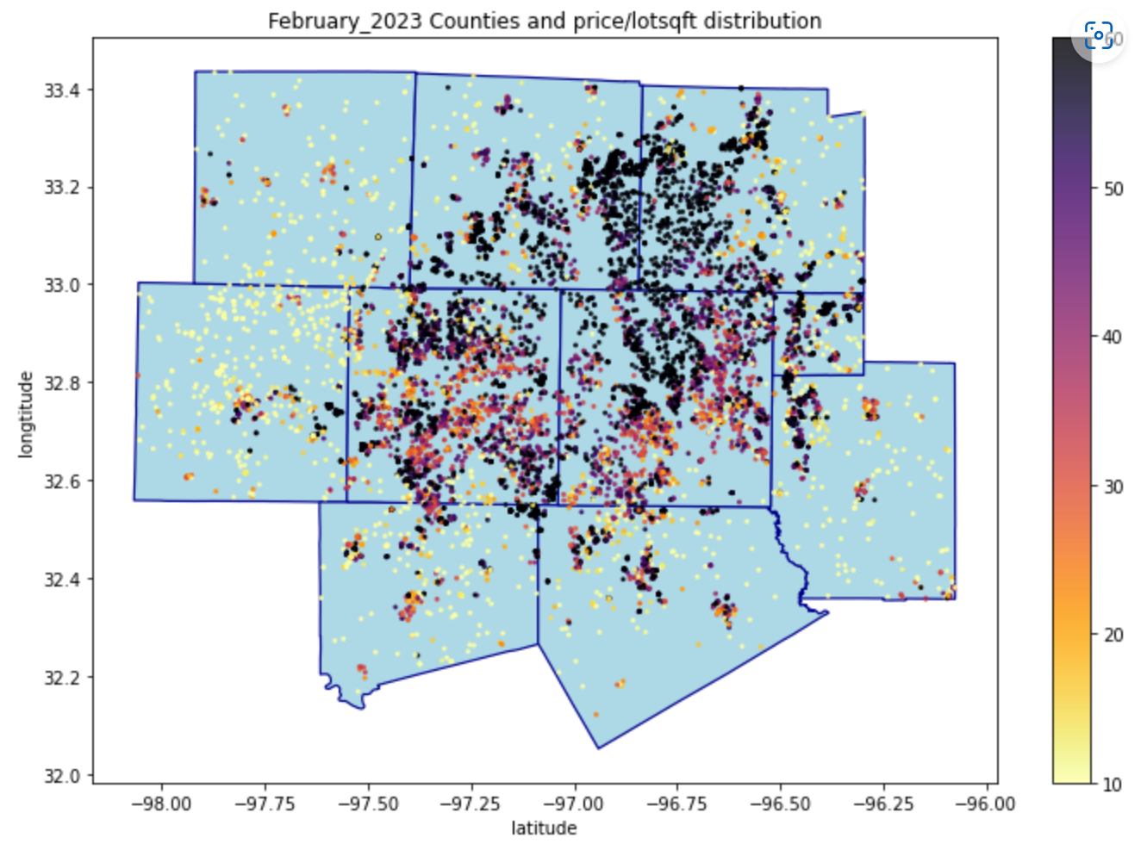
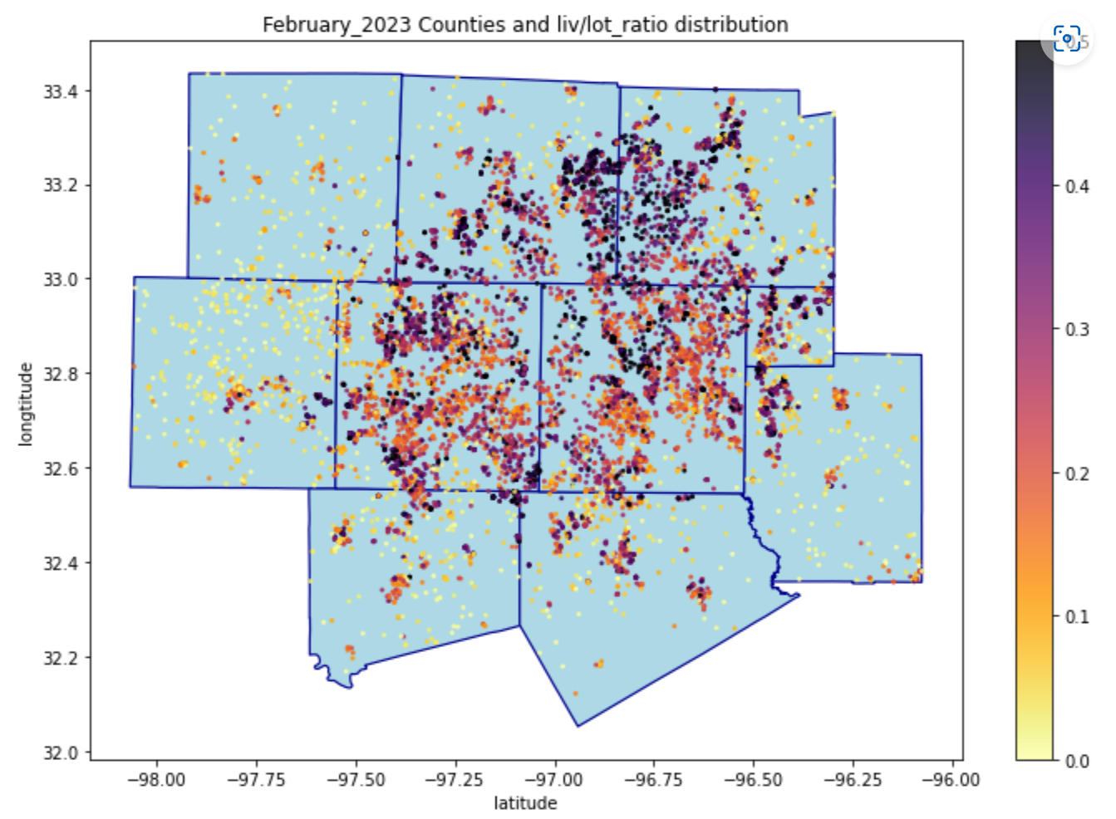
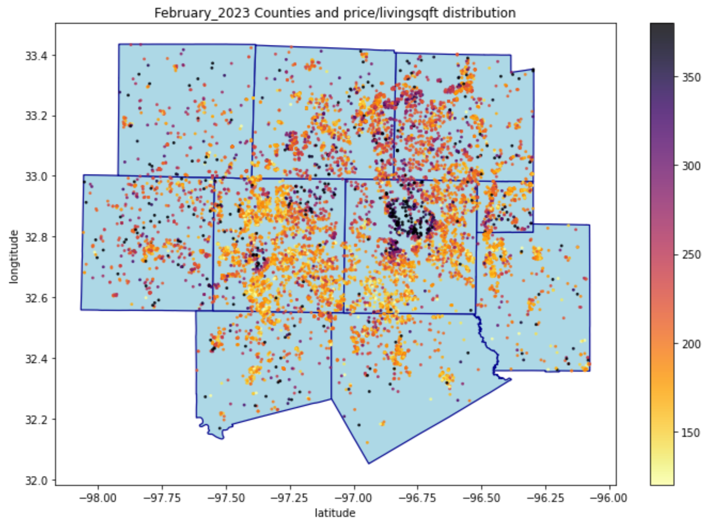
Counties (February)

Slide 3
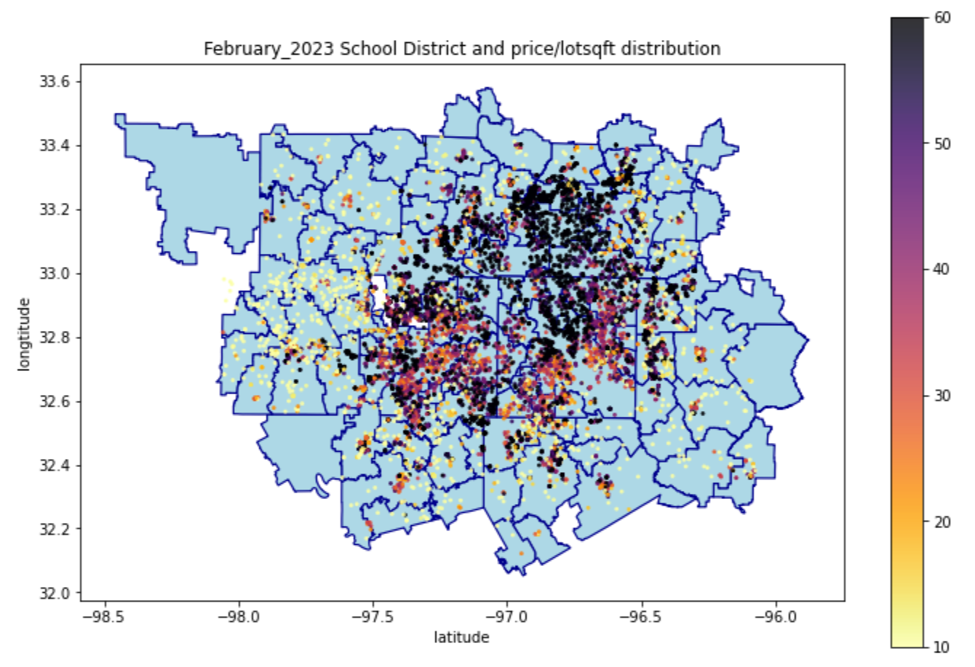
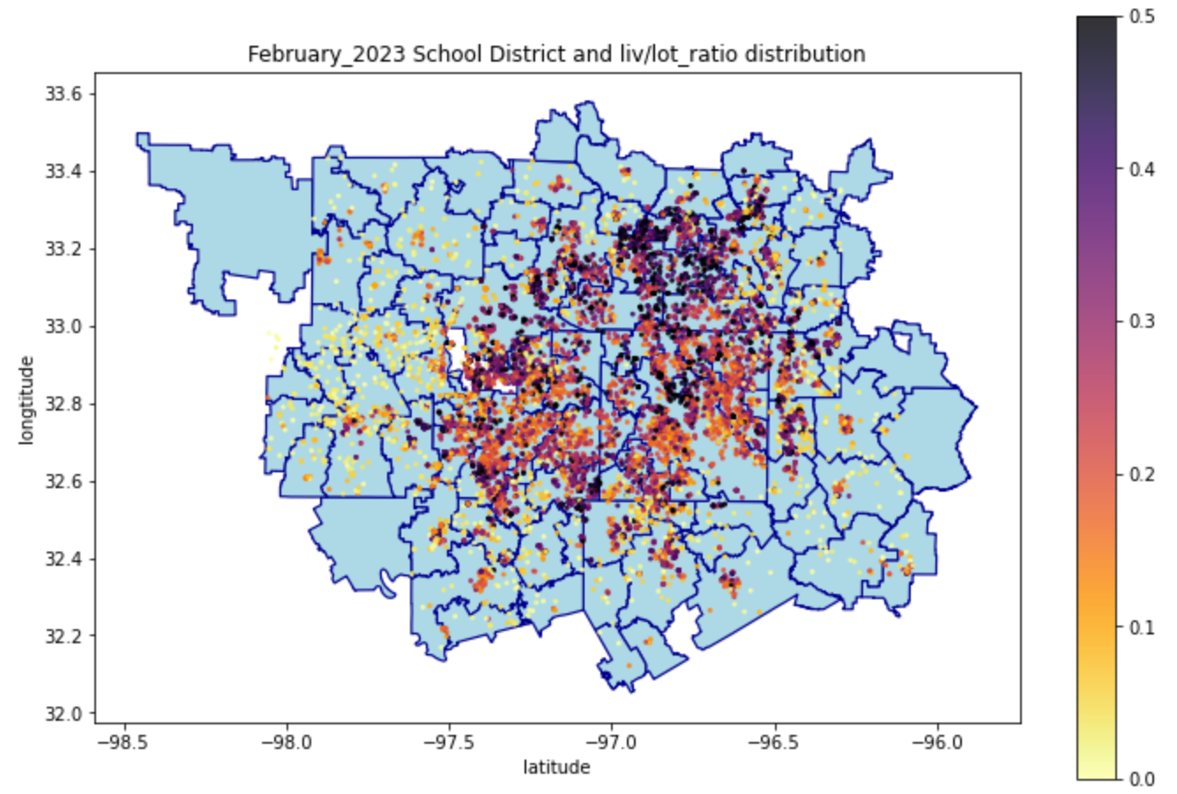
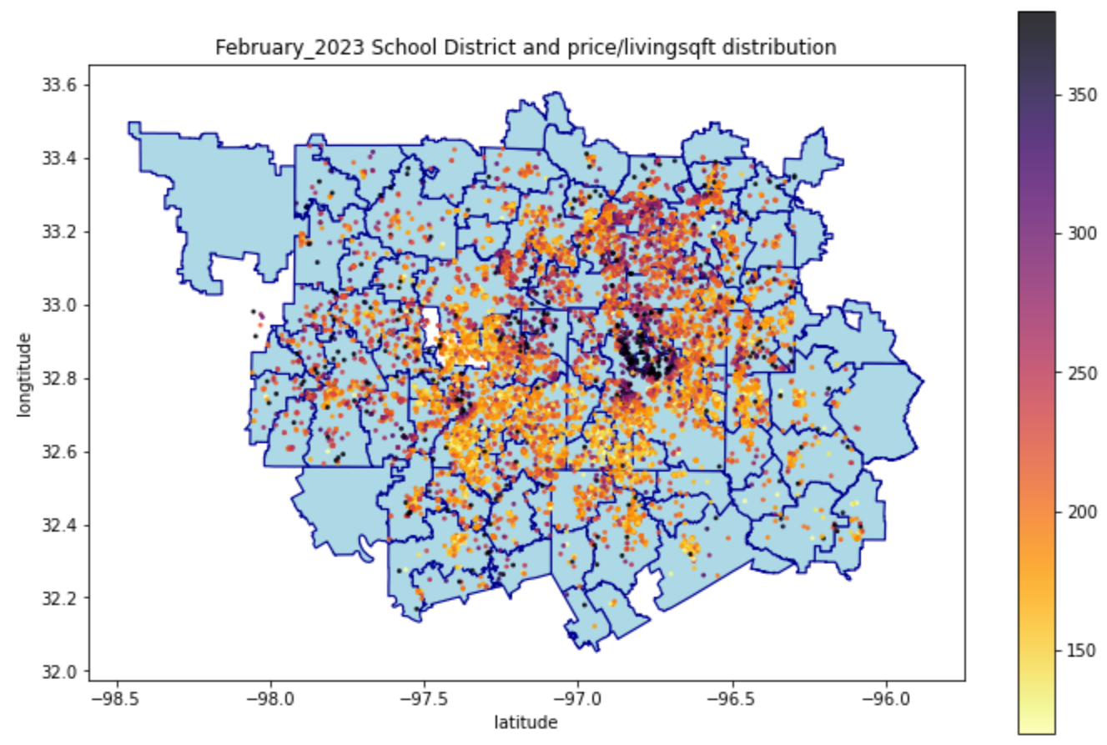
School District (February)

Slide 4
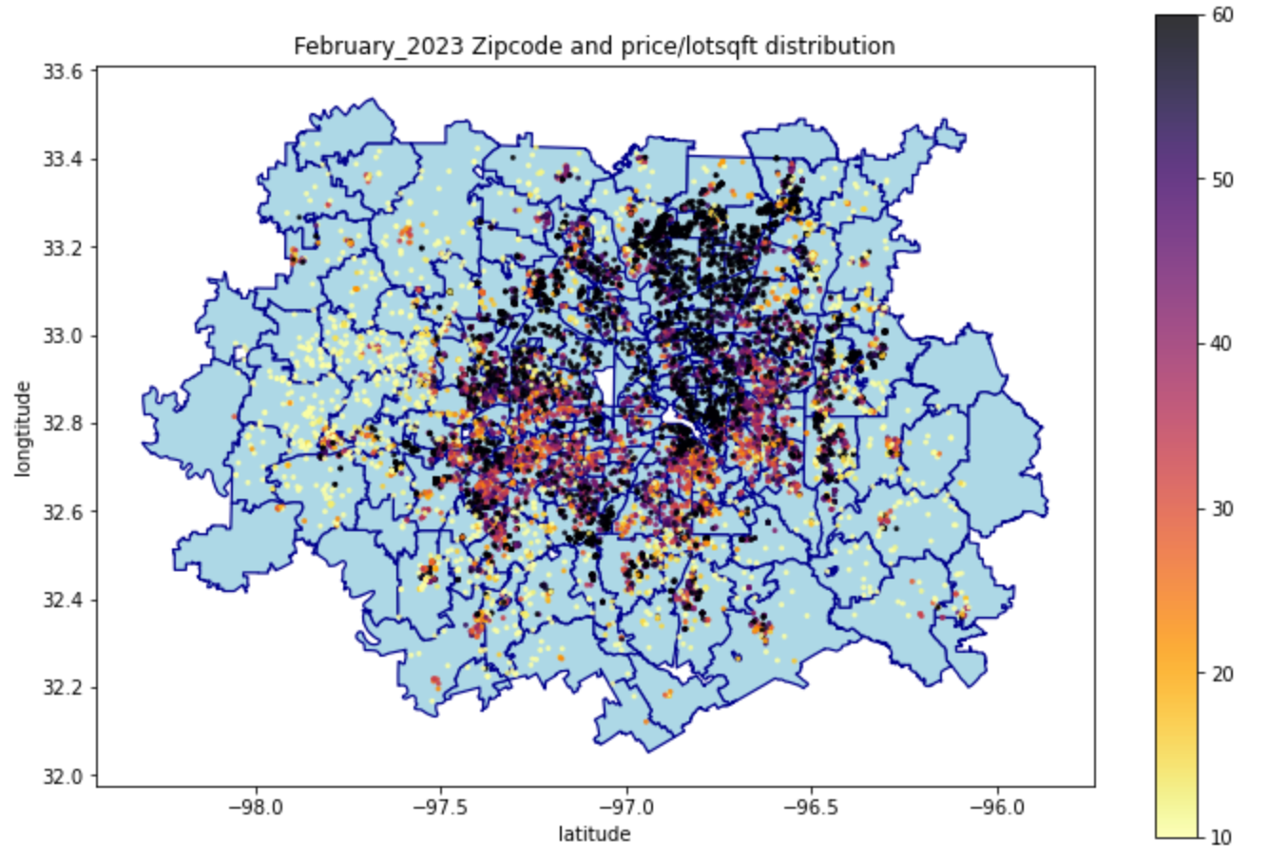
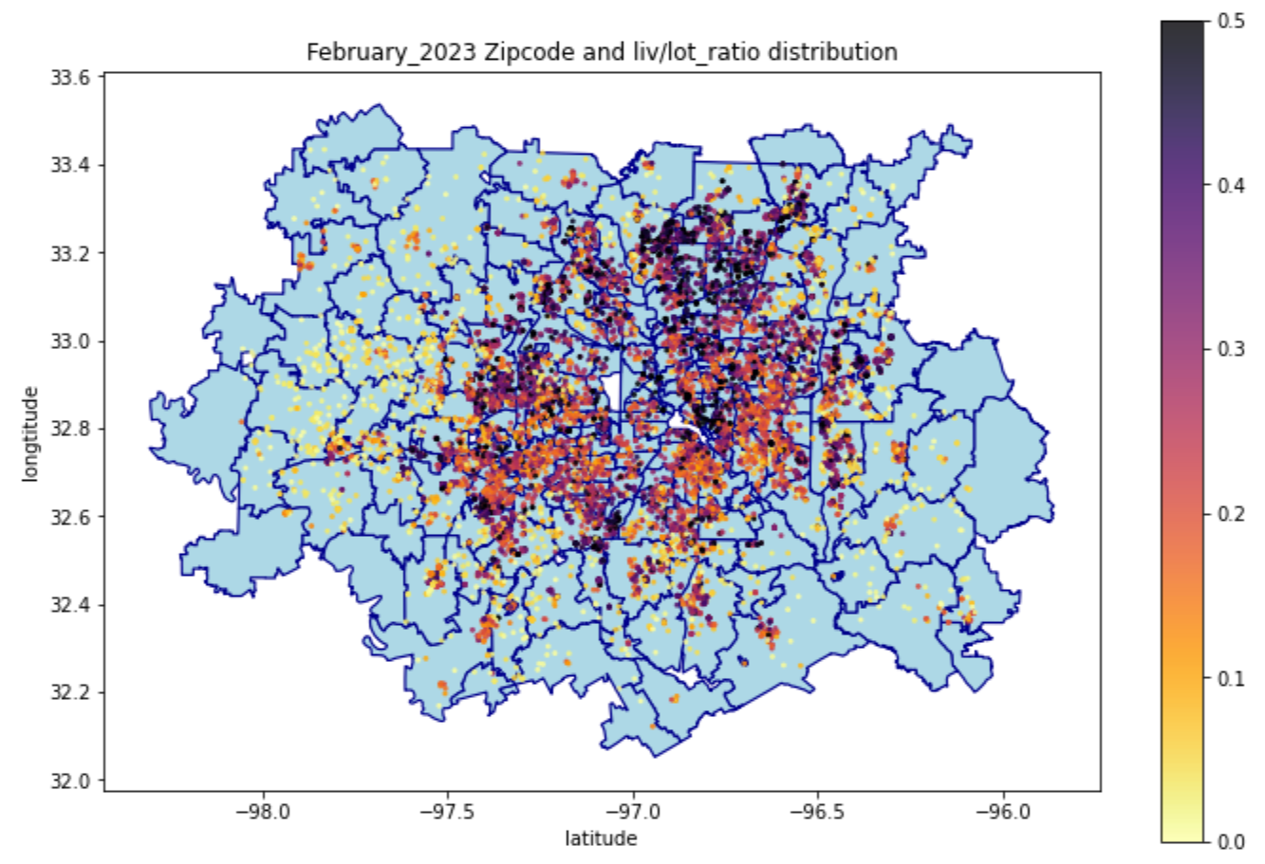
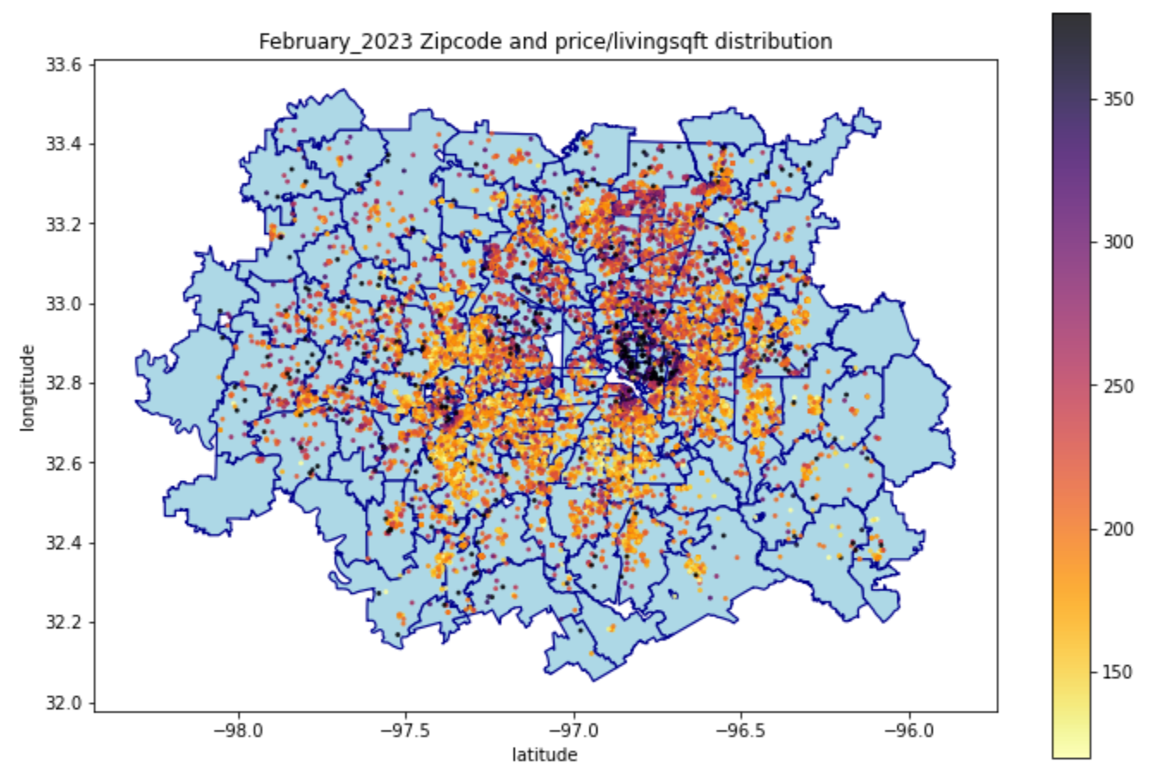
zIPCODE (February)

Slide 5
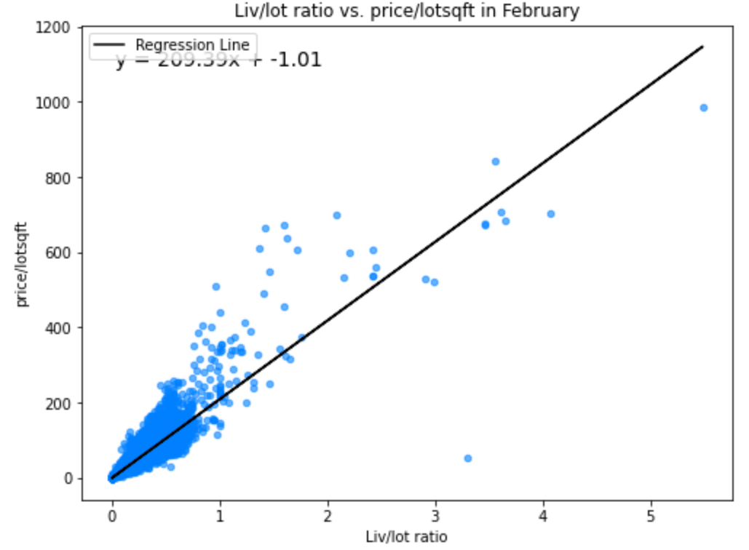
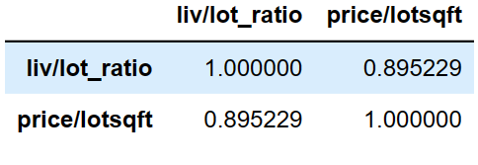
Liv/lot ratio vs. price/lot area (February)

Slide 6
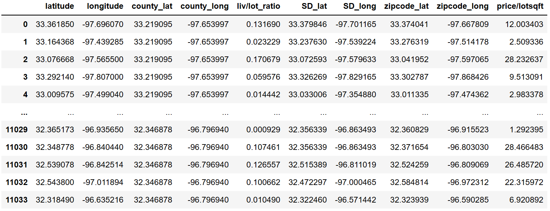
LOCATION ML
Price/lotsqft is the target variable
The rest are features.
Conditions for the samples (houses) to be selected for ML/DL:
+ Lot Area != 0
+ price/lotsqft <= 1000
+ living area to lot area ratio <= 2

Slide 7
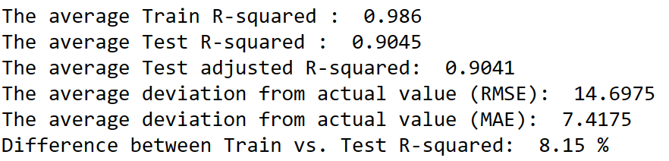
Random forest (raw features)
5-Fold cross validation
No scaled features or target

Slide 8
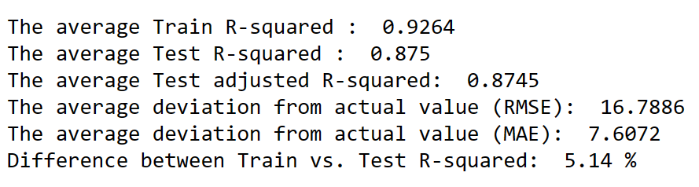
HistGradientboostingregressor
5-Fold cross validation
No scaled features or target
5-Fold cross validation
No scaled features or target

Slide 9
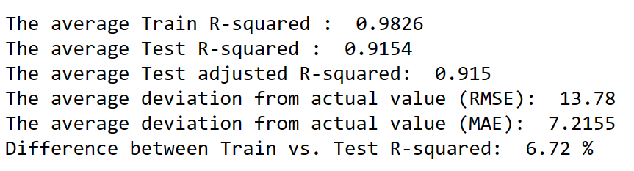
XGB Regressor
5-Fold cross validation
No scaled features or target

Slide 10
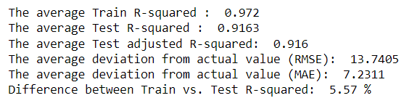
XGB REGRESSOR (tuned)
5-Fold cross validation
No scaled features or target

Slide 11

2000 neurons each layer, with the final 2 layers with dropouts = 0.2
Dense -> ReLu -> Dropout
ANN ARCHITECTURE

Slide 12
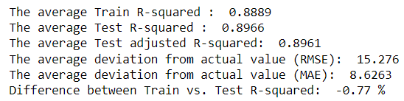
ANN Performance
5-Fold Cross Validation
Scale Features with MinMaxScaler()
Scale target with np.log
Evaluate the model with np.exp(predictions)

Slide 13
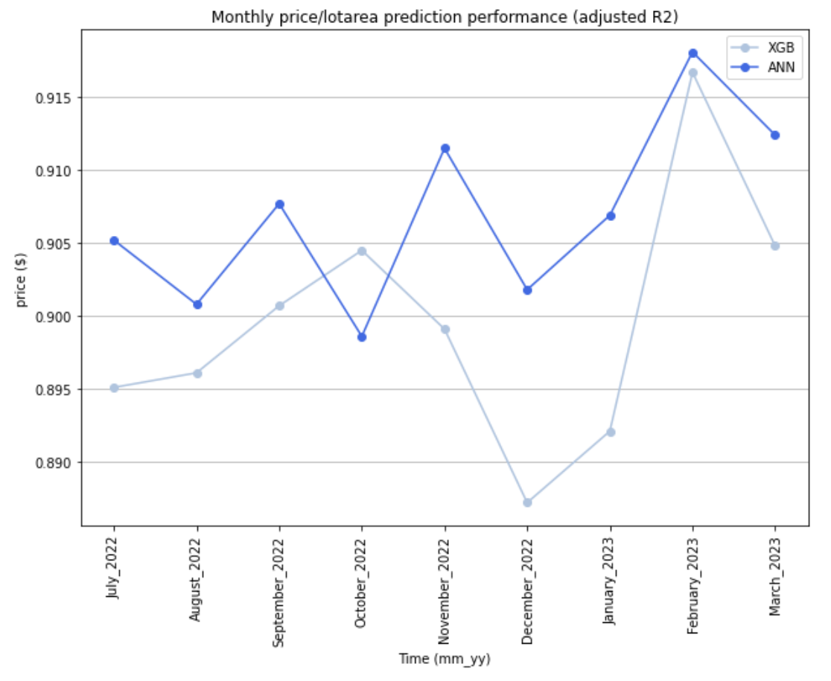
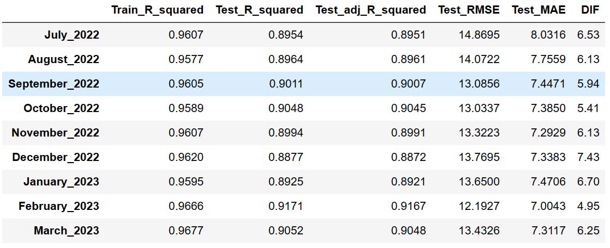
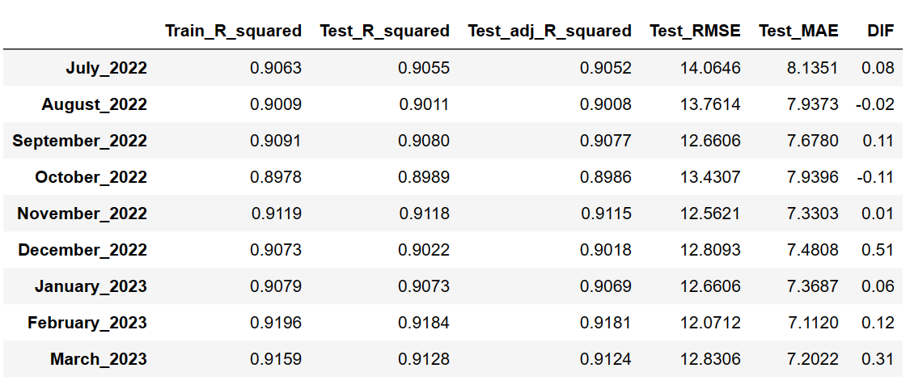
XGB vs. ANN (Adjusted r2)

Slide 14
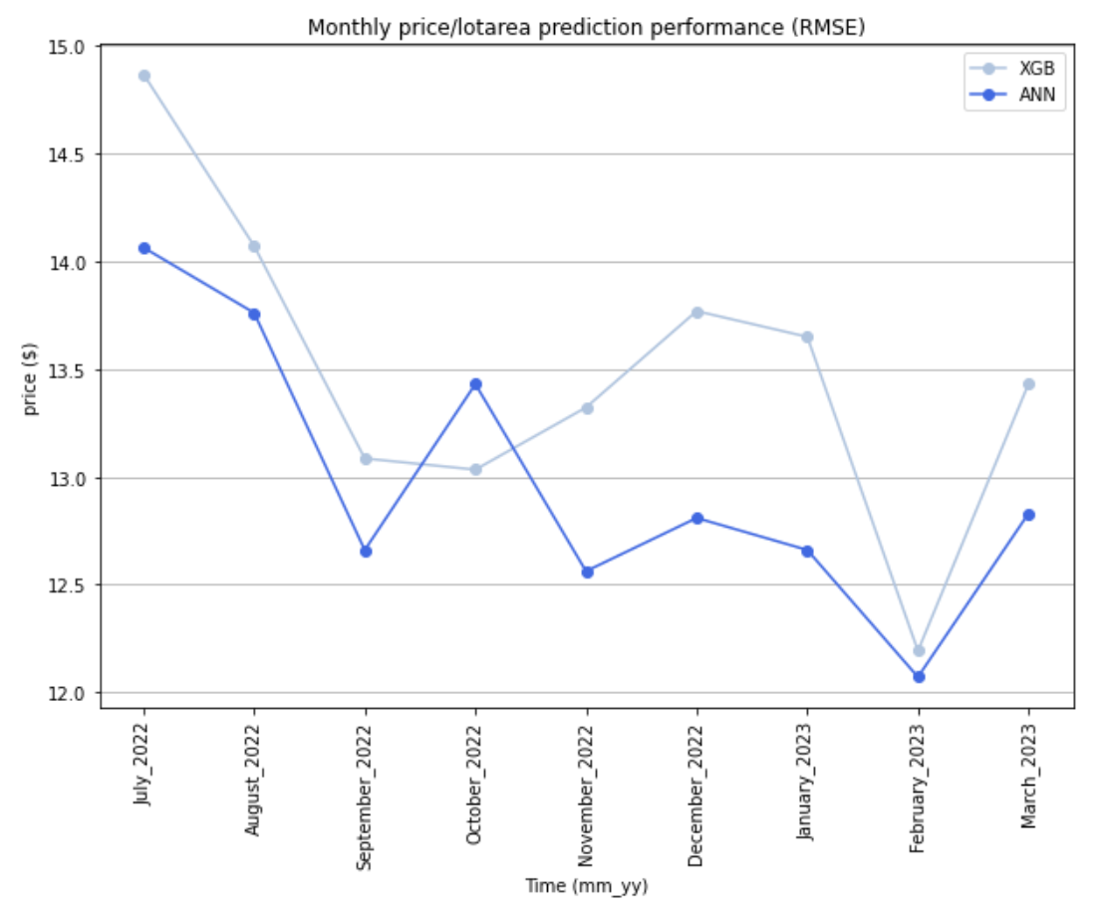
XGB vs. ANN (RMSE)

Slide 15
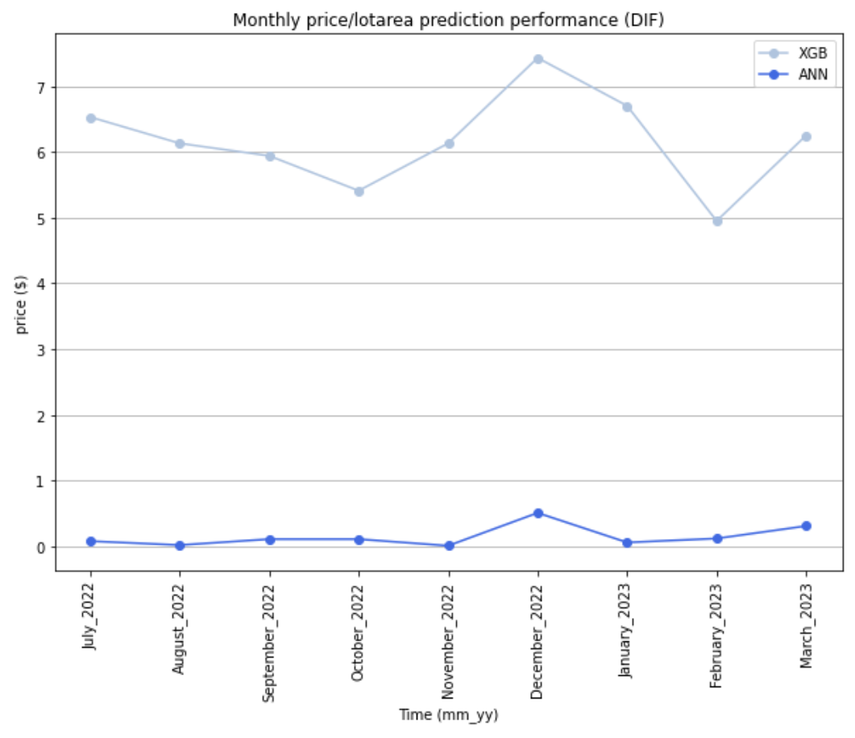
XGB vs. ANN (Dif = Abs(Test r-squared – Train R-squared))

Slide 16
XGB VS. ANN
ANN has higher R-squared and lower RMSE.
ANN generalized better.
=> ANN performs better with location data.

